Slide 1



Department of Computer Science and Engineering
FeedChain – Smart Donation and Leftover Food Mapper
Guide Name
Dr.P.Deepa M.E.,Ph.D.
Team Members Name / Register Number
ENOCH JACKSON C 2023PECCS743
GOWTHAMAN V P 2023PECCS761

Slide 2
Introduction
Abstract:
FeedChain is a smart digital platform designed to minimize food wastage by automating food donation workflows. It connects Donors, NGOs, and Volunteers through role-based portals and uses geolocation, NGO capacity, and food perishability for intelligent matching. The system ensures secure handovers using OTP/QR codes, enables real-time tracking, and maintains transparency with blockchain. A built-in chatbot assists users, while volunteers earn rewards for successful deliveries. Developed with Java, JSP/Servlets, and MySQL, FeedChain enhances speed, trust, and coordination in food distribution. Future upgrades include AI-based forecasting and IoT freshness monitoring, supporting SDG 2: Zero Hunger and SDG 1: No Poverty.

Slide 3
Review of Literature
S.No | Title | Authors | Year | Source
1 | Smart Food Rescue System Using ML and Cloud | Raktim Raihan Prova, A S M Rayhan, Rafia Sultana Shilon, Mohammad Monirujjaman Khan | 2021 | IEEE - 51525
2 | Food waste management using Android Studio | Katakam Sudheepa, Padmashetti Rashmitha, P.Sardar Maran | 2023 | IEEE Xplore (ICAAIC 2023)
3 | Share and Care: A Food Donation Web Application | V. Sarvasri Sowmya Lakshmi, M.N.V. Surekha, P. Sasi Sanjana, R. Jyothi Sai Durga, M. Charan Sri Sai5 | 2024 | ISSN
4 | A Novel Approach for Identification and Donation of Surplus Food using Machine Learning-based Replate App | R. Kavitha, V Nuthan Prasad, Dankan Gowda V, Umayal M, Subhiksha 5,Anitha K | 2023 | IEEE (ICAISS 2023)
5 | Developing Food Charity Operations Management System | Nwadher Alblihed, nd Mai Almutairi, Refaf Almahmoud, Suliman Aladhadh | 2022 | IEEE (ICCIT)
6 | Do VIR Virtualizing Food Donation Distribution through Mobile Application and Cloud-Based Supply Chain Management | Divy Chhibber, Aditi Tripathi and Sandip Ray | 2021 | IEEE(ICCE2021)
7 | Machine Learning-based Reduction of Food Remains and Delivery of Food to the Needy | Veda Vidhya, Ajmeera Kiran, T BHASKAR, Dr. Santhosh Boddupalli | 2021 | IEEE Xplore
8 | An Examination on Food, Clothes and Books Donation Based Android Application | Garima Pandey, Amit Kumar, | 2022 | IEEE (ICERECT)
methodology
Uses ML and cloud to match surplus food with recipients
Built in Android Studio to manage and redistribute food waste.
Built a web app to facilitate food donations and requests with real-time tracking and database management.
Implemented a machine learning-based web app to identify surplus food and streamline its donation to needy recipients.
Developed a web-based system to manage and streamline food charity operations efficiently
Created a mobile and cloud-based system to virtualize and manage food donation distribution efficiently
ML identifies extra food and delivers it to the needy
Android app to facilitate donation of food, clothes, and books

Slide 4
S.No | Title | Authors | Year | Source
9 | Machine Learning Based Approach to Reduce Food Wastag | N.M Ifham, M.I.M Abdulla, M.R.M Rifadh, M.N.M Hussain Ajward, N.H.P. Ravi Supunya Swarnakantha, Karthiga Rajendran | 2024 | IEEE Conference Publication
10 | Nutrient Food Prediction Through Deep Learning | Saikat Banerjee, Abhoy Chand Mondal | 2021 | IEEE Conference Publication
11 | Machine Learning based Food Sales Prediction using Random Forest Regression | Hruthvik Naik, Kakumanu Yashwanth, Suraj P, N. Jayapandian | 2022 | IEEE Conference Publication
12 | A Food Wastage Reduction Mobile Application | Hassan Hajjdiab, Ayesha Anzer, Hadeel A. Tabaza, Wedad Ahmed | 2018 | IEEE Conference Publication
13 | Foodernity: A Mobile and Web Application for Food Sharing | John Amiel R. Morilla, Fhillip Carl Bagsic, Mark Kenneth Dela Cruz, Carl Daniel A. Patio, Emeliza R. Yabut | 2021 | IEEE Conference Publication
14 | An Android Application Development for Food Donation: A Geographical Location Based Approach | Arvind Kumar Pandey, Pratik Patel | 2022 | IEEE Conference Publication
15 | SeVa: A Food Donation App for Smart Living | Christina Varghese, Drashti Pathak, Aparna S. Varde | 2021 | IEEE Conference Publication
metmethodology
ML predicts surplus food and directs it to the needy
Deep learning estimates nutrient content of food
Random Forest predicts food sales to optimize supply
Mobile app connects excess food with people in need
Platform enables sharing of surplus food via web and mobile
Android app uses location to match surplus food with nearby recipients
App streamlines donation of food to reduce wastage and help the needy

Slide 5
Existing System
Manual or semi-digital platforms used for food donation.
Communication between Donors, NGOs, and Volunteers is mostly via calls or basic apps.
Matching is based on fixed rules or manual effort (e.g., proximity only).
Lack of real-time updates and structured tracking.
Feedback, if any, is informal and unstructured.
Disadvantages
High food spoilage due to slow matching.
No urgency-based or capacity-aware allocation.
Minimal automation leads to delays and errors.
Poor tracking of donations and deliveries.
Difficult to scale across regions or user types.

Slide 6
Proposed System – FeedChain
A smart digital platform that automates food donation workflows.
Connects Donors, NGOs, and Volunteers via role-based portals.
Uses geolocation, perishability, and NGO capacity for intelligent matching.
Enables real-time status tracking, feedback collection, and volunteer coordination.
Ensure secure handover of food donations using OTP codes or QR scans
Assign nearest available volunteer automatically

Slide 7
Donations are prioritized based on food perishability and NGO need (e.g., hot meals delivered first).
NGOs are matched only if they have storage or serving capacity (avoid overload & spoilage).
Every donation logged on a blockchain ledger so donors/NGOs can trust the process (tamper-proof).
Volunteers earn points/badges for successful deliveries → improves motivation.
A chatbot helps donors/NGOs with quick queries (e.g., "How do I donate?" "Track my delivery").

Slide 8
Advantages
Faster donation delivery
Transparency & trust with blockchain
Enhanced volunteer motivation
Real-time tracking
Smart matching (NGO capacity, geolocation, perishability)
User support & automation via chatbot

Slide 9
Implementation
Requirement Analysis
System Design
Frontend Development (UI for Donor, NGO, Volunteer, Admin)
Backend Development (Java, Servlets/JSP, APIs)
Database Setup (MySQL tables: Users, Donations, Matches, Volunteer Tasks, Feedback)
Integration (connect frontend, backend, database; OTP/QR, geolocation, matching)
Testing & Validation
Deployment (Cloud: AWS/Firebase/Railway)
Future Enhancements (AI prediction, blockchain, multi-language, IoT)

Slide 10
Security Measures
Role-Based Access Control (Donor, NGO, Volunteer, Admin)
OTP/QR verification for secure donation handover
Data encryption (in transit and at rest)
Secure login & authentication (password hashing, session management)
Audit trails / activity logging for accountability
Input validation to prevent malicious data
Regular backups to prevent data loss

Slide 11
System Architecture
Presentation Tier (Frontend/UI Layer):-
Purpose: Interface for users (Donor, NGO, Volunteer, Admin) to interact with the system.
Tech Used: HTML, CSS, JavaScript
Responsibilities:
Login/Register pages for each role
Food donation form
NGO dashboard for approvals
Volunteer pickup interface
Status tracking & feedback forms

Slide 12
2. Application Tier (Business Logic Layer):-
Purpose: Core processing layer where all logic is handled.
Tech Used: Java (Servlets or JSP), JDBC
Responsibilities:
Authenticating users
Matching food donations to NGOs using rules (perishability, proximity, capacity)
Assigning and notifying volunteers
Handling feedback collection
Managing role-based access
Sending status updates and confirmations

Slide 13
3. Data Tier (Database Layer):-
Purpose: Stores all persistent data required by the system.
Tech Used: MySQL
Tables:
users (Donors, NGOs, Volunteers, Admins)
donations (food details, timestamps, donor ID)
matches (donation-NGO mapping, status)
volunteer_tasks (pickup assignments)
feedback (ratings and reviews)

Slide 14
Modules
NGO Module
Volunteer Module
Admin Module
Feedback & Rating Module
Notification & Tracking Module
AI/Chatbot Assistance Module

Slide 15
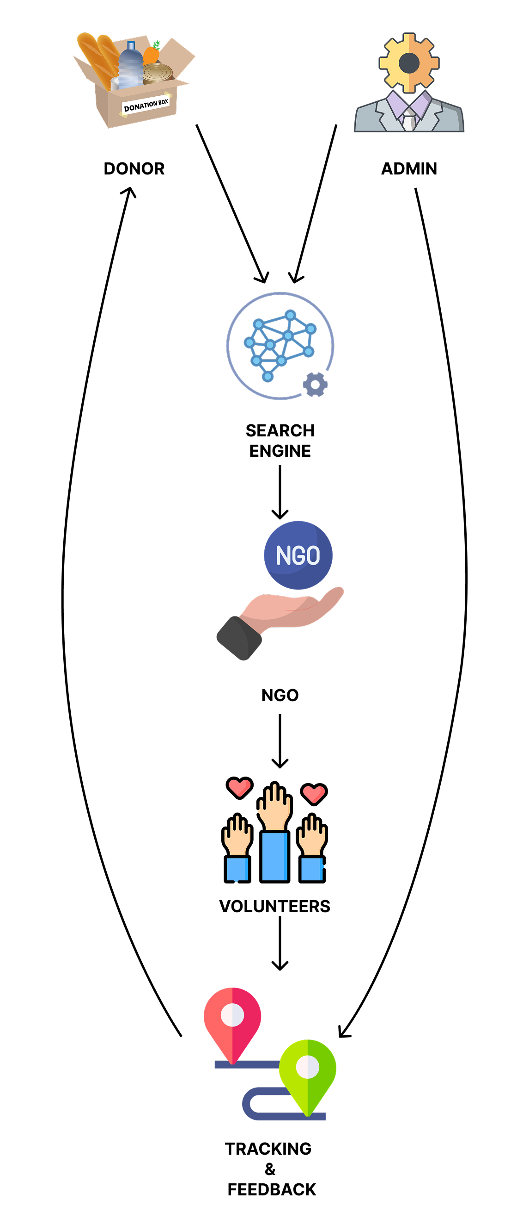
System Architecture Diagram

Slide 16
Flow Diagram
DONOR POSTS FOOD DETAILS
BACKEND MATCHES NGO
NGO ACCEPTS DONATION
VOLUNTEER ASSIGNED
LIVE TRACKING FOOD
DELIVERY CONFIRMED
FEEDBACK COLLECTED
Admin

Slide 17
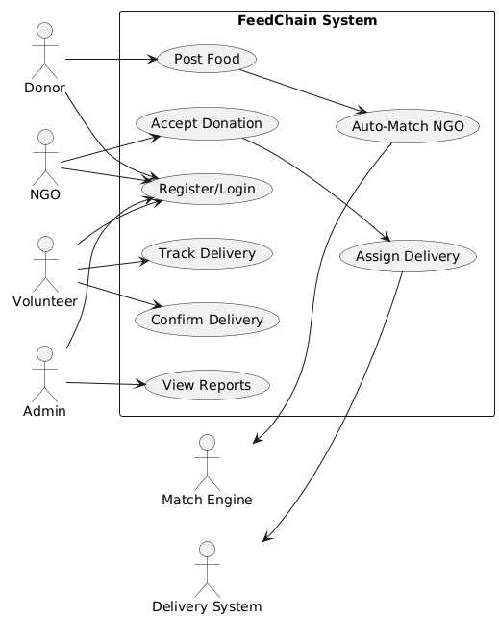
Use Case Diagram

Slide 18
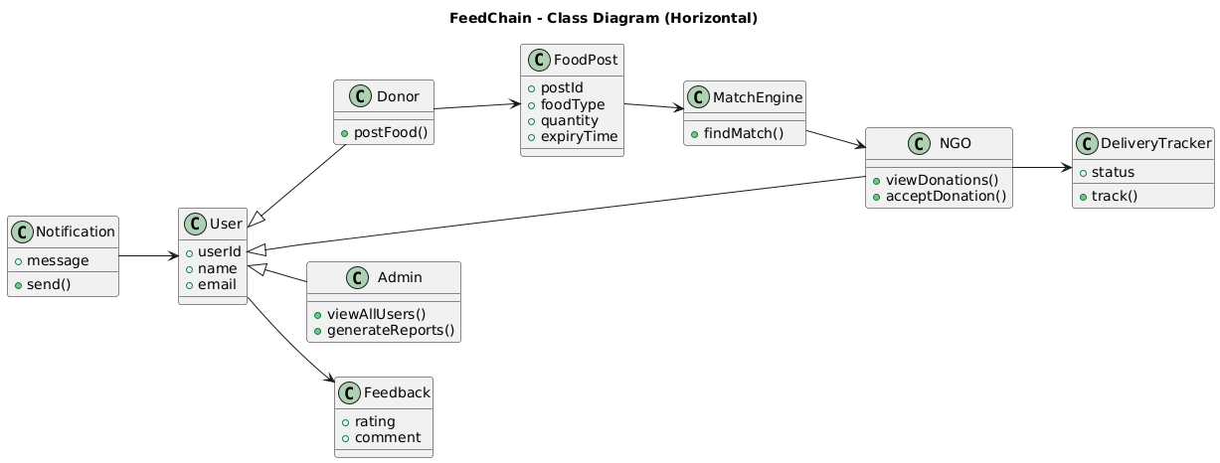
Class Diagram

Slide 19
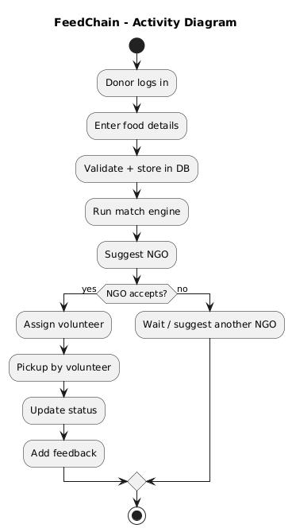
Activity Diagram

Slide 20
FeedChain Contributions:
Smart Match Engine for optimized NGO selection
Volunteer assignment & tracking system
Secure OTP/QR confirmation at delivery
Map visualization with Leaflet.js & OpenStreetMap
Analytics + feedback loop for reporting
Cloud-native backend (Firebase, Railway) for scalability
Directly aligned with SDG 2: Zero Hunger and SDG 1: No Poverty

Slide 21
Future Scope
AI-powered donation forecasting
Blockchain-based transparency for donations
Real-time IoT monitoring of food temperature & freshness
Smart volunteer routing & delivery optimization
Gamification & rewards for volunteers
Integration with government & CSR programs

Slide 22
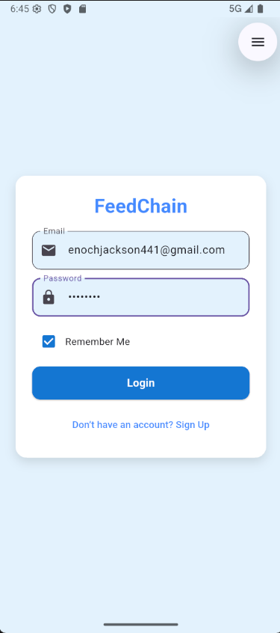
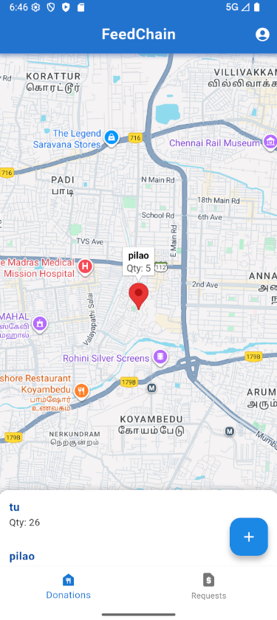
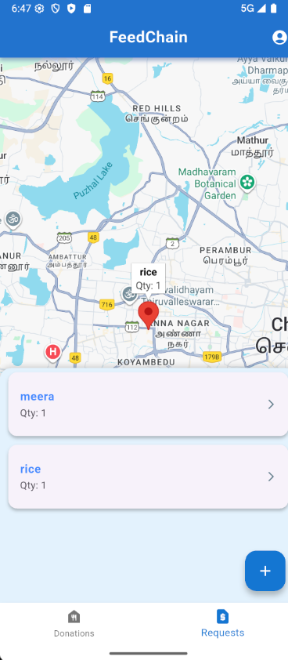
Implementation
Fig 1
Fig 2
Fig 3

Slide 23
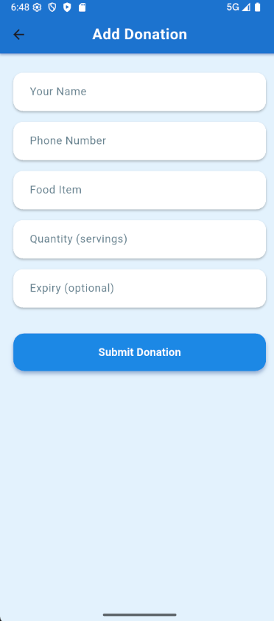
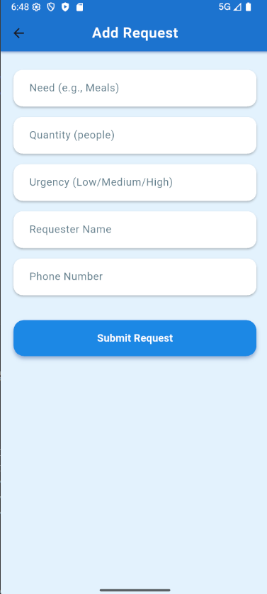
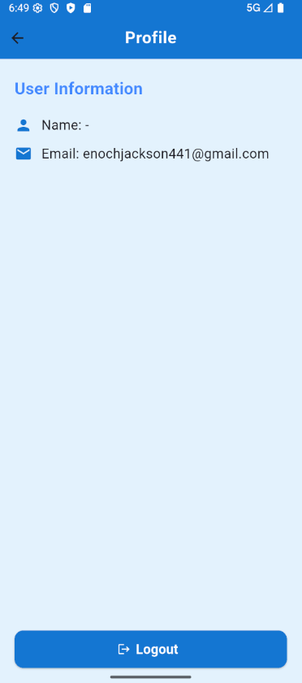
Fig 4
Fig 5
Fig 6

Slide 24
References
IEEE: https://ieeexplore.ieee.org/document/10124322
FAO Reports: https://www.fao.org/india
OpenStreetMap: https://www.openstreetmap.org
Firebase Docs: https://firebase.google.com
15 IEEE and academic journal papers (2021–2025)

Slide 25
Expected Outcome
Working product prototype (FeedChain)
Research paper submission (IEEE / Scopus)
Copyright or Patent (UI/ML Matching)
Pitch for CSR funding / NGO collaboration
Ready for inter-college hackathons

